Slide 1

Academic referencing
Dr Alveen Singh
Department of Information Technology
Research skills\Project 3A
Advanced Diploma in ICT\B.ICT
Semester 1 2023

Slide 2
Content
The importance of referencing
In text citations and bibliography
DUT/Harvard referencing style
Software tools

Slide 3

Introduction
Referencing is acknowledging the work of other authors
One cannot produce a high quality research work without citing the work of others

Slide 4
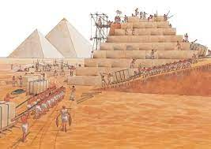
Various fields of science are advanced by first acknowledging and then building on the research of others
Not acknowledging the work of others is stealing
Plagiarism is not tolerated in any scientific community and there are dire consequences for its practice
Quora.com

Slide 5
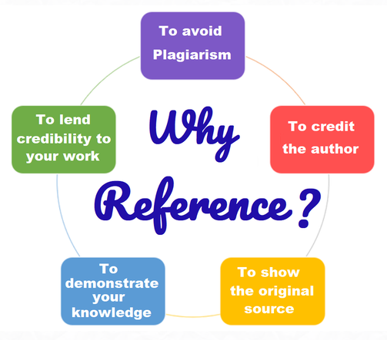
Virtual library.info

Slide 6
The importance of referencing
To acknowledge the finished work and/or ideas of other researchers
To show engagement and sound understanding of the field of research
To demonstrate a clear understanding of recent and relevant literature
To add scientific credibility to the research
  Otherwise, no one will believe your hearsay

Slide 7
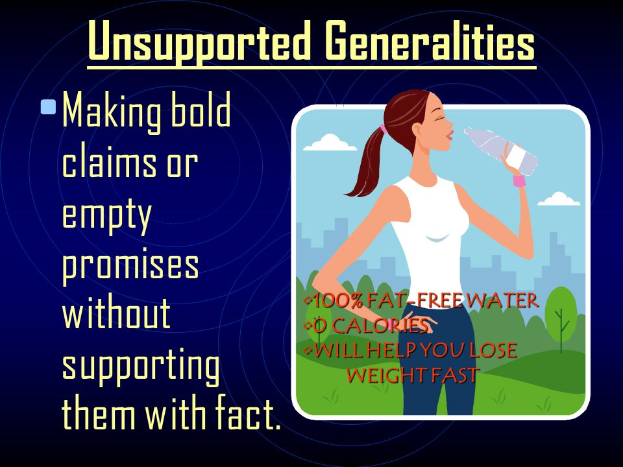
Statements and claims must be supported by references
Fletcher

Slide 8
Which is a good reason to reference?
To bulk up the document
To achieve a large number reference list
To support statements made in the writeup
To make the writeup look scientific

Slide 9
In-text referencing (citations)
Allows the reader to identify the source of the statement or claim
E.g.
  In this globalized 4IR era, emerging technology is incessantly used to provide efficient access to services and products and increase production levels by organisations across economic sectors (Zaied, 2012, Stančić,Ivanjko and Garic, 2017).
  Hass (2015) states that time and again the practice of business analysis eludes to a highly regarded discipline within organizations.
  BABOK Guide (2015) defines business analysis as: “the practice of enabling change in an enterprise by defining needs and recommending solutions that deliver value to stakeholders” (BABOK, 2015: 2)

Slide 10
Direct quotations
This is part of the original work that has been repeated verbatim.
It is a statement that adds value or supports your own write-up
Placed within quotation marks “ ” and contains the page number of
the original work
These failures more often than not relate to insufficient planning and design and gaps between project design and actual reality. This is elaborated below:
  “Although requirements practices are of critical importance for public organizations and their ability to meet the changing needs of their constituents, the state-of-the-art is that practitioners dedicate very little attention to their methodical application, and researchers focus insufficiently on the unique challenges and demands posed by the public and governmental context” (Alexandrova, 2012, p. 339).
  Beware of overuse of direct quotations.
  Instead, paraphrase.
Student’s statement
A direct quote to support the student’s statements

Slide 11
What is the error in the reference?
Tamburri, D.A. 2020. Sustainable mlops: Trends and challenges. In 2020 22nd international symposium on symbolic and numeric algorithms for scientific computing (SYNASC), pp. 17-23. IEEE.
T.Y. Fujii. 2021. A digital twin architecture model applied with MLOps techniques to improve short-term energy consumption prediction. Machines, 10(1), pp.23.
Hanzelik, P.P., Kummer, A. and Abonyi, J. Sensors. Edge-computing and machine-learning-based framework for software sensor development. 22(11), pp.4268.

Slide 12
3. DUT/Harvard referencing style
In-text examples
Single author –
  According to Mkhize (2021), convolutional neural network algorithm is a popular choice for credit card fraud detection.
Two or three authors –
  Gama, Singh and Zulu (2018) highlight the shortcomings of UX designs in e-Learning management systems.
Four of more authors –
  Dlamini et al. (2020) stress the increasing usage of bitcoin in the SME sector.
Direct quotation –
  “Despite the boom, advances in ICT are seemingly almost always slightly behind developments in cyber-crime” (Garvin, 2019: 21).

Slide 13
Reference list/Bibliography
At the end of the write-up include a list of utilized references
This includes the full details of the cited work
Arranged in alphabetical order

Slide 14
Which is the correct reference for a journal article, conference proceeding, website and book?
  Mkhize, LMP. 2021. Credit card fraud detection: a deep learning alternative. Available: http://www.aiontheedge.com/article/onlinefraud/mkize21 (accessed 10 January 2021).
  Dlamini, X. M., Martin, A., Naidoo, P. and Pallad, S. 2020. The new currency trends. ICT for Development and Finance, 65(5): 166-186.
  Gama, T. Q. P., Singh, V. and Zulu, X. P. 2018. Improving UX for university 4.0: A case study. In: ICTAS 2018. Durban, South Africa, 14-16 March 2018. IEEE Computer Society.
  Garvin, J. 2019. The great escape: how Africa is losing to cybercrime. London. Wiley.

Slide 15
Reference list examples:
Website –
  Mkhize, LMP. 2021. Credit card fraud detection: a deep learning alternative. Available: http://www.aiontheedge.com/article/onlinefraud/mkize21 (accessed 10 January 2021).
Journal article –
  Dlamini, X. M., Martin, A., Naidoo, P. and Pallad, S. 2020. The new currency trends. ICT for Development and Finance, 65(5): 166-186.
Conference proceeding –
  Gama, T. Q. P., Singh, V. and Zulu, X. P. 2018. Improving UX for university 4.0: A case study. In: ICTAS 2018. Durban, South Africa, 14-16 March 2018. IEEE Computer Society.
Book –
  Garvin, J. 2019. The great escape: how Africa is losing to cybercrime. London. Wiley.

Slide 16
What type of reference is this?
Heck, P., Schouten, G. and Cruz, L., 2021. A software engineering perspective on building production-ready machine learning systems. In Handbook of research on applied data science and artificial intelligence in business and industry (pp. 23-54). IGI Global.

Slide 17
Matavire, R., Chigona, W., Roode, D., Sewchurran, K., Davids, Z., Mukudu, A. & Boamah-Abu, C. 2010. Challenges of egovernment project implementation in a South African context. Electronic Journal of Information Systems Evaluation, 13, 153.
Mathiesen, P., Bandara, W., Delavari, H., Harmon, P. & Brennan, K. 2011. A comparative analysis of business analysis (BA) and business process management (BPM) capabilities. ECIS 2011 Proceedings. Barcelona, Spain.
Mawela, T. 2017. Exploring the role of social media in the G2C relationship: a South African perspective. Information Development, 33, 117-132.

Slide 18
What is the referencing style?
The BBC asked in its title whether, with GPT-3, we have seen our AI future (Cellan-Jones, 2020). The New York Times wrote that machines “are getting terrifyingly good” at writing (Manjoo, 2020:5). The Telegraph opined that “we should be very worried about AI-generated text” (Pagnamenta, 2020:12).
The BBC asked in its title whether, with GPT-3, we have seen our AI future [3]. The New York Times wrote that machines “are getting terrifyingly good” at writing [7]. [12] noted that “GPT-3 can be eerily human-like – for better and for worse”. The Telegraph opined that “we should be very worried about AI-generated text” [14].

Slide 19
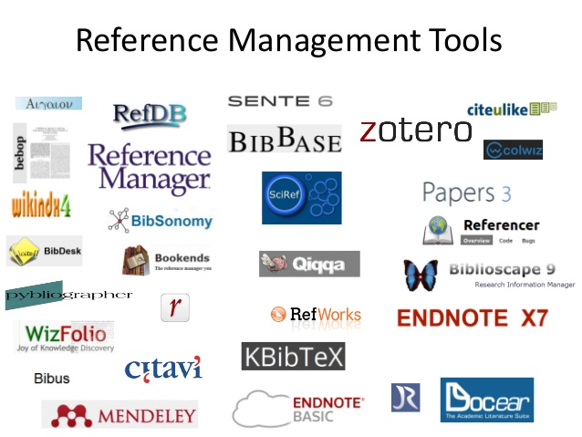

Slide 20
Please read the lecture note for this section.
Available on Moodle.
Questions and comments are welcome: alveens@dut.ac.za

